Slide 1
DMCalc: Tutorial
Pratik Tarafdar &
M. A. Krishnakumar

Slide 2

A short intro to DM
Pulsar signals are dispersed - Thanks to free electrons in ISM
The delay is a strong function of frequency ~ 𝝂⁻²
Dispersion Measure (DM) is the integrated column density of electrons between pulsar and observer

Slide 3
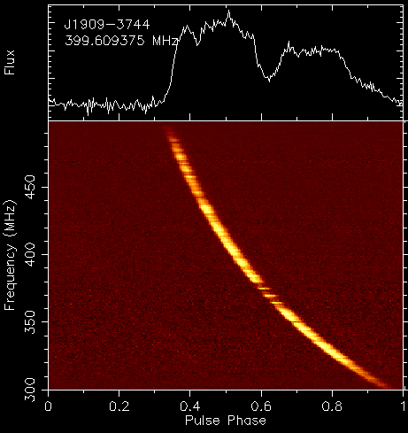
A short intro to DM
Pulsar signals are dispersed - Thanks to free electrons in ISM
The delay is a strong function of frequency ~ 𝝂⁻²
Quantified as
DM - a measure of electron density
𝝂₂
𝝂₁

Slide 4
A short intro to DM
Pulsar signals are dispersed - Thanks to free electrons in ISM
The delay is a strong function of frequency ~ 𝝂⁻²
Quantified as
DM - a measure of electron density
𝝂₂
𝝂₁

Slide 5
A short intro to DM
Pulsar signals are dispersed - Thanks to free electrons in ISM
The delay is a strong function of frequency ~ 𝝂⁻²
Quantified as
DM - a measure of electron density
Correct for the delay - dedispersion
𝝂₂
𝝂₁

Slide 6
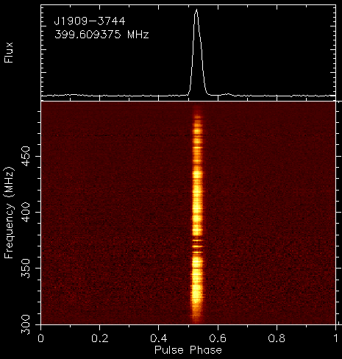
A short intro to DM
Pulsar signals are dispersed - Thanks to free electrons in ISM
The delay is a strong function of frequency ~ 𝝂⁻²
Quantified as
DM - a measure of electron density
Correct for the delay - dedispersion
𝝂₂
𝝂₁
Why should we worry??

Slide 7
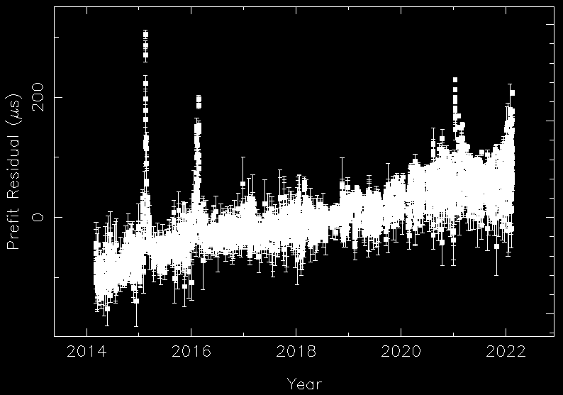
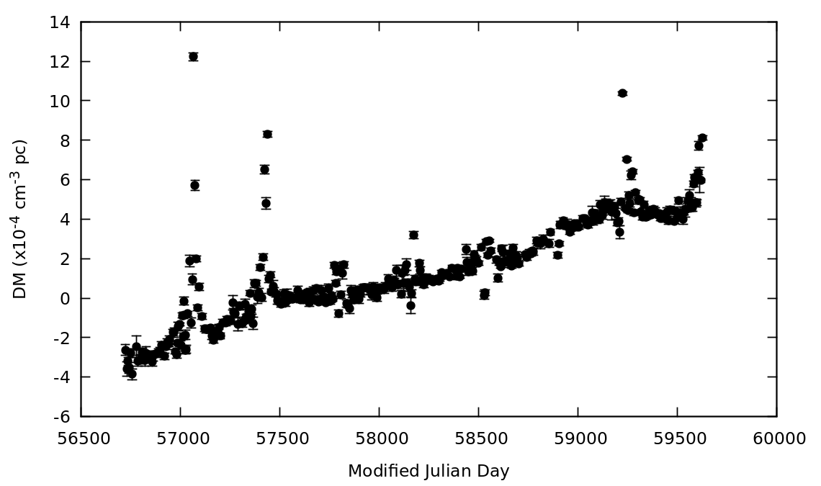
DM variations affecting ToAs
LOFAR observations (120 - 190 MHz) of PSR J2145-0750
ToAs follow DM variation very well
Change in pulsar period (dP/dt) also show similar trend
DM correction will help model the other pulsar parameters better
And ultimately useful for PTAs to detect GWs

Slide 8
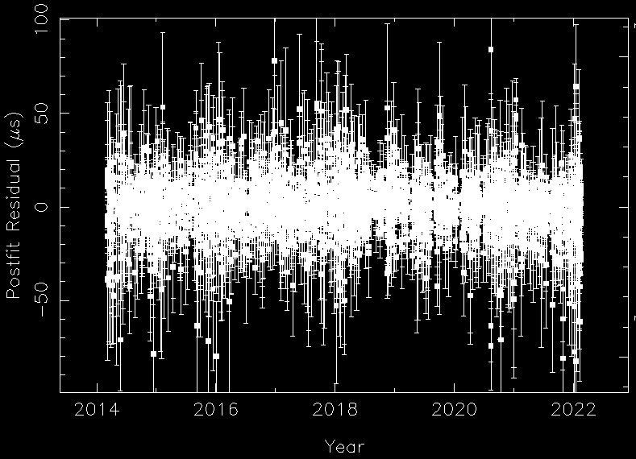
DM variations affecting ToAs
LOFAR observations (120 - 190 MHz) of PSR J2145-0750
ToAs follow DM variation very well
Change in pulsar period (dP/dt) also show similar trend
DM correction will help model the other pulsar parameters better
And ultimately useful for PTAs to detect GWs

Slide 9
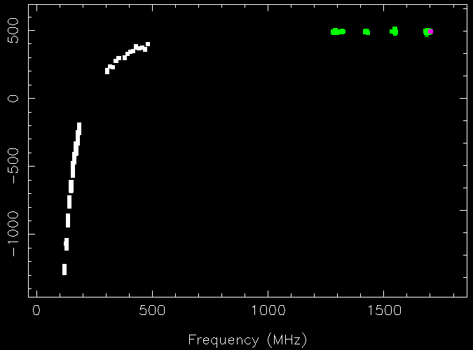
Lower frequency - better precision
Since DM delay scales as 𝝂⁻² lower frequency wide-band receivers improve precision
Combining different telescope’s data across frequencies improves it further (plot shows data from LOFAR (120 - 190 MHz) - uGMRT (300 - 500 MHz) - NRT (1250 - 1750 MHz)
Not all pulsars are visible below ~200 MHz – Importance of uGMRT bands

Slide 10
Different ways to measure DM
Classically, Use 2-3 widely separated narrowband profiles
Maximising the S/N - Not accurate as profiles are complex
Narrowband timing - DM and its variation
With wide-band receivers:
Use of frequency resolved templates (Liu et al. 2014; Tiburzi et al. 2019)
2D templates
Improved accuracy
Takes care of intrinsic profile evolution
Use of wide-band technique (Pennucci et al. 2019; Alam et al. 2021)
2D templates
PCAs to model the profile evolution
One ToA/band/observation - reduces data volume for PTA analysis

Slide 11
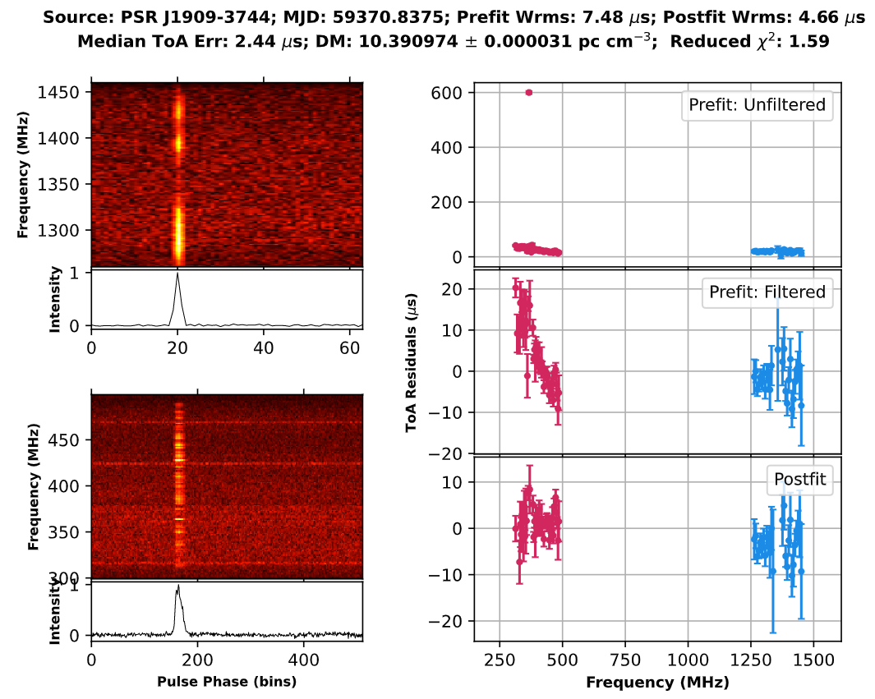
DMCalc
A Python package to estimate DM (Krishnakumar et al. 2021)
Dependencies: PSRCHIVE (with Python bindings), TEMPO2, scikit-learn, etc.
What it does?
Find/measure ToAs (using psrchive python bindings)
Reject large outliers (using Huber regression)
Fit for DM with TEMPO2
Products
DM timeseries
Analysis plot
ToAs with different PTA specific flags and parameter file with epoch dependent DM constraints (DMMODEL and DMX)
Over to Pratik for the hands-on exercise…

